Slide 1
Introduction to Computer Systems
By: Iman Khani Jazani
Senior Data Scientist, Adin
Technical AI Product Manager and Advisor, Mehra
NLP Researcher, VoXera
Adjunct Professor, Sharif University of Technology

Slide 2
Last lecture
Course Information
Discussion about Programming and Python in Research and Industries
Why we use Python
How to use Python

Slide 3
Today
Review the Last Lecture
History of Computation and Computers
Component of a Computer System
Type of Programs in Computers
Algorithm: Programs Brain
Application of Programming in the Digital Age!

Slide 4
Together
Send your feedback about the class whenever you want!

Slide 5
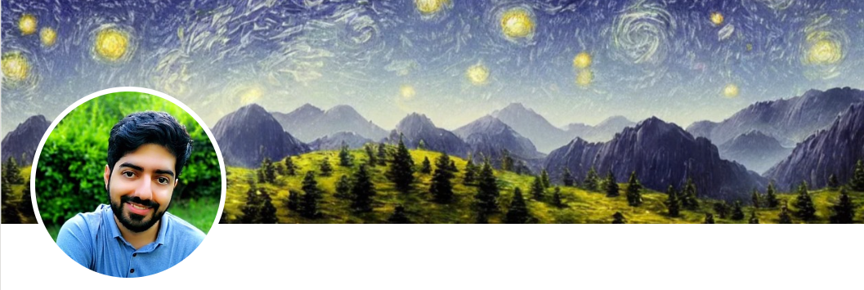
Contact me
Gmail: ImanKhaniJazani@gmail.com
LinkedIn: https://www.linkedin.com/in/ImanKhaniJazani/
Telegram: @IKJ1992

Slide 6

Main links for our class
حتمنه حتمن عضو بشین!
Telegram group: t.me/SharifPythonSpace1401
GitHub organization: github.com/SharifPythonSpace

Slide 7
Review the Last Lecture

Slide 8
Grading
اخرین فرصت ارسال پیشنهادات: 1401/11/29
Approx. 25% Programming Assignments (judgment with Quera)
Approx. 14% Mid-term Project (alone, judgment with TAs and Quera)
Approx. 37% Final Project (team work~5 member, judgment with TAs and Quera)
Proposal (about real needs)
Coding
Release
Approx. 30% Final Exam
Approx. 5% Presentation with Code(extra score)
Approx. 2% Challenging Questions and Contributions in Class (extra score)
Notes:
113 score

Slide 9
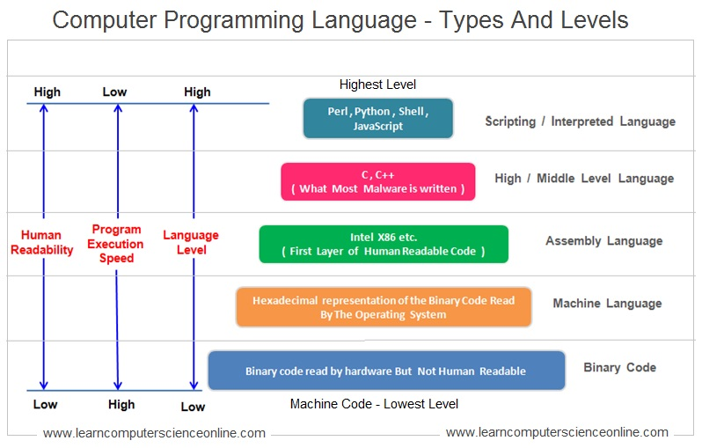
Language!

Slide 10
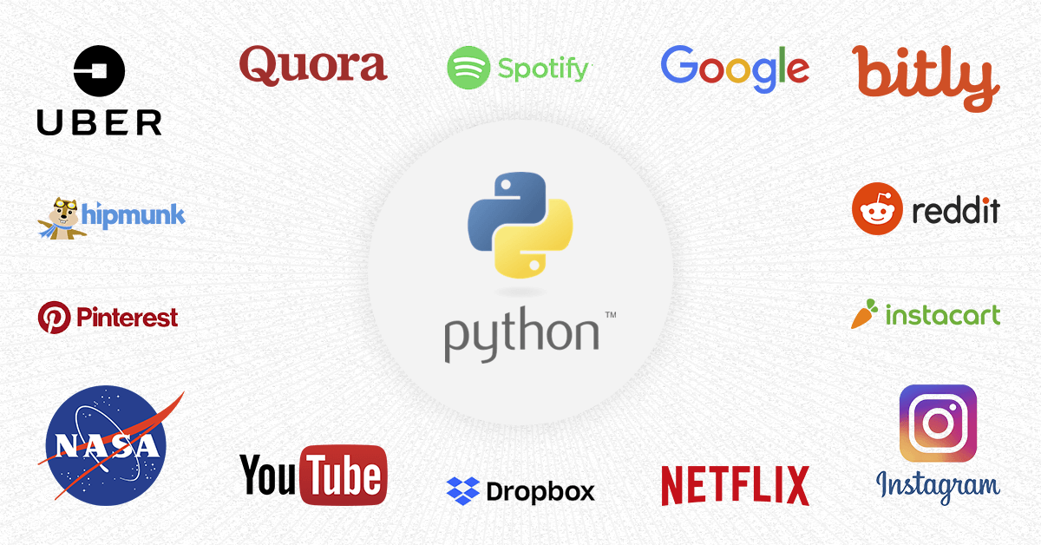
Do you know about its applications?

Slide 11
History of Computation and Computers

Slide 12
From computing…
The history of computing is longer than the history of computing hardware and modern computing technology and includes the history of methods intended for pen and paper or for chalk and slate, with or without the aid of tables.

Slide 13

From computing…
Eventually, the concept of numbers became concrete and familiar enough for counting to arise, at times with sing-song mnemonics to teach sequences to others. All known human languages, except the Piraha language, have words for at least "one" and "two", and even some animals like the blackbird can distinguish a surprising number of items

Slide 14
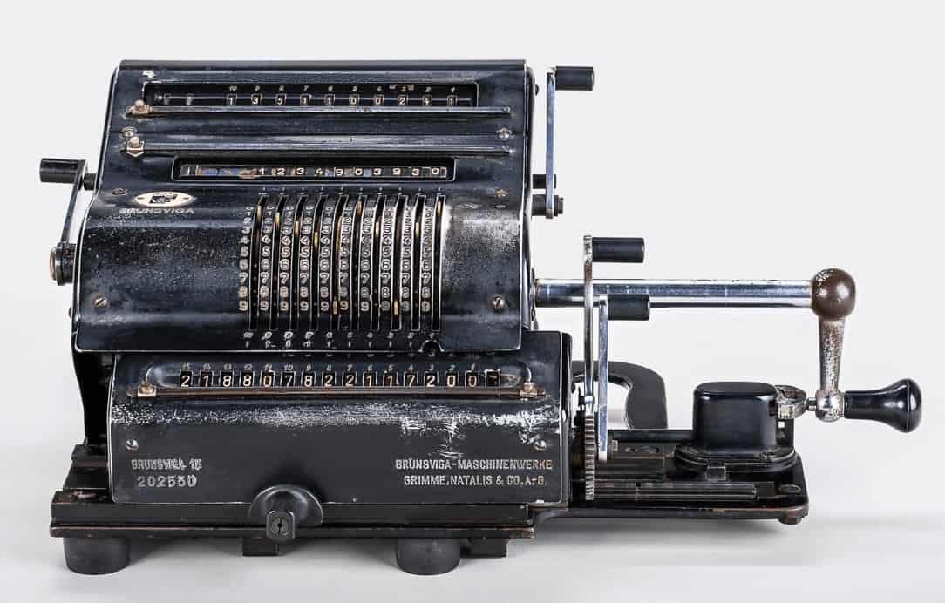
From computing…
The first aids to computation were purely mechanical devices which required the operator to set up the initial values of an elementary arithmetic operation, then manipulate the device to obtain the result.

Slide 15
Timeline
1600
Mechanical Calculators
1700
Difference Engine
1800
Hollerith Tabulating Machine
Pascaline
Jacquard Loom
Analytical Engine
Punched Card Tabulating Machines
Teletype
Vacuum Tube
1900
Transistor
Integrated Circuit
Microprocessor
Personal Computer
2000
Cloud Computing
Tablets
Smartphones
Internet of Things (IoT)
3000

Slide 16
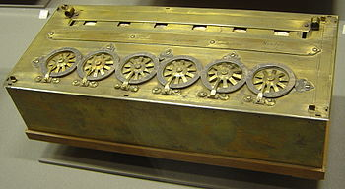
Pascaline
چرا اختراع شد؟!

Slide 17
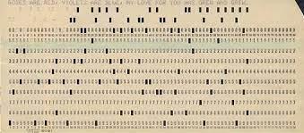
Punched card
اگه بخوایم ویرایش کنیم چی؟!

Slide 18

Punched card machine

Slide 19
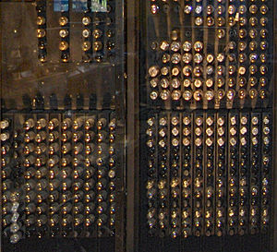
Vacuum tube computers
17000 لامپ خلا

Slide 20
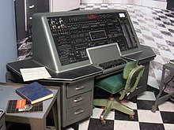
UNIVAC (UNIVersal Automatic Computer)

Slide 21
Components of a Computer System

Slide 22
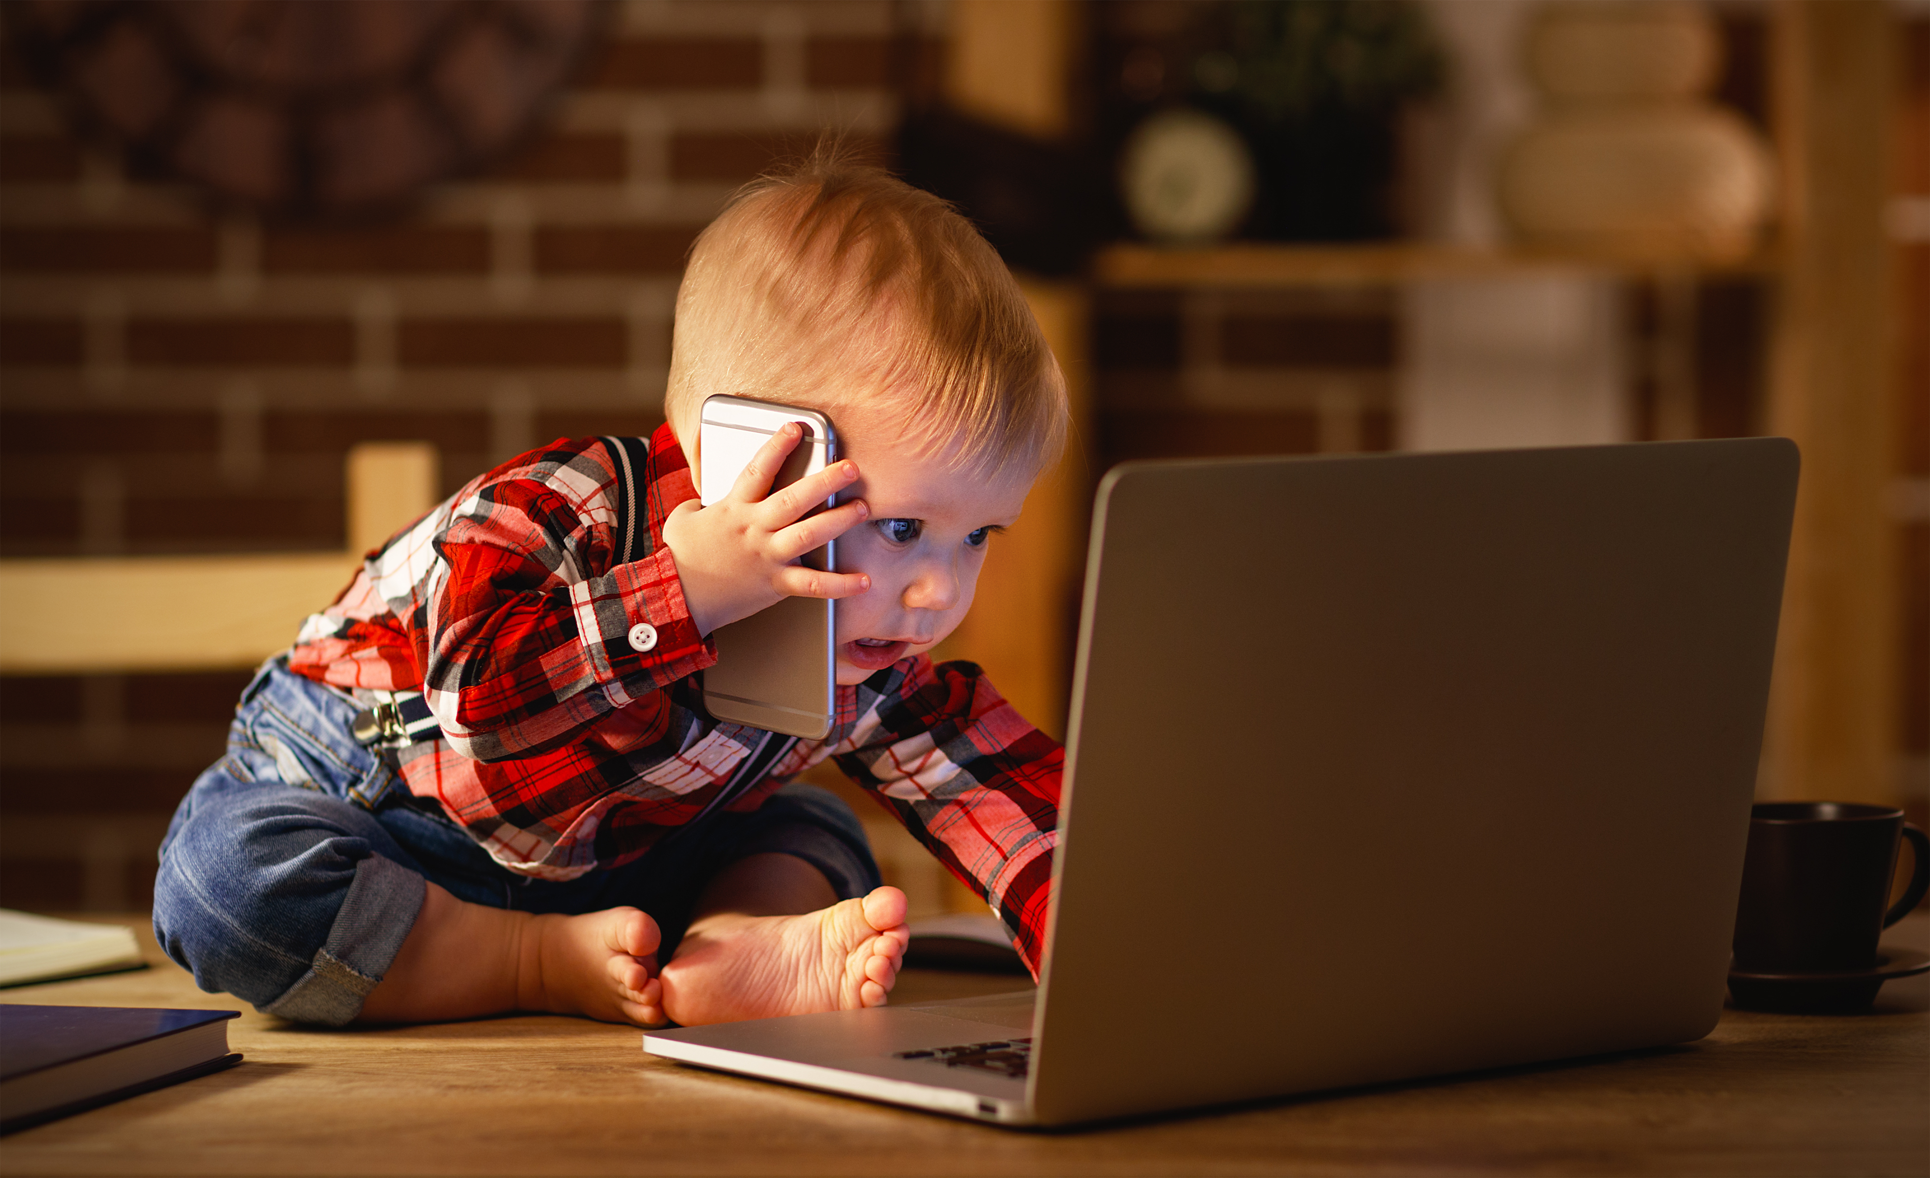
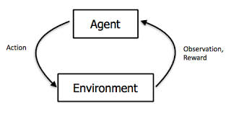
Computer is like a human!?
نرم افزار، سخت افزار، ورودی و خروجی...

Slide 23
What is computer in general?
A computer is a complex and modular system (in its hardware and software) for problem solving, computing, and data processing in different domains.
Input
Processing
Output

Slide 24
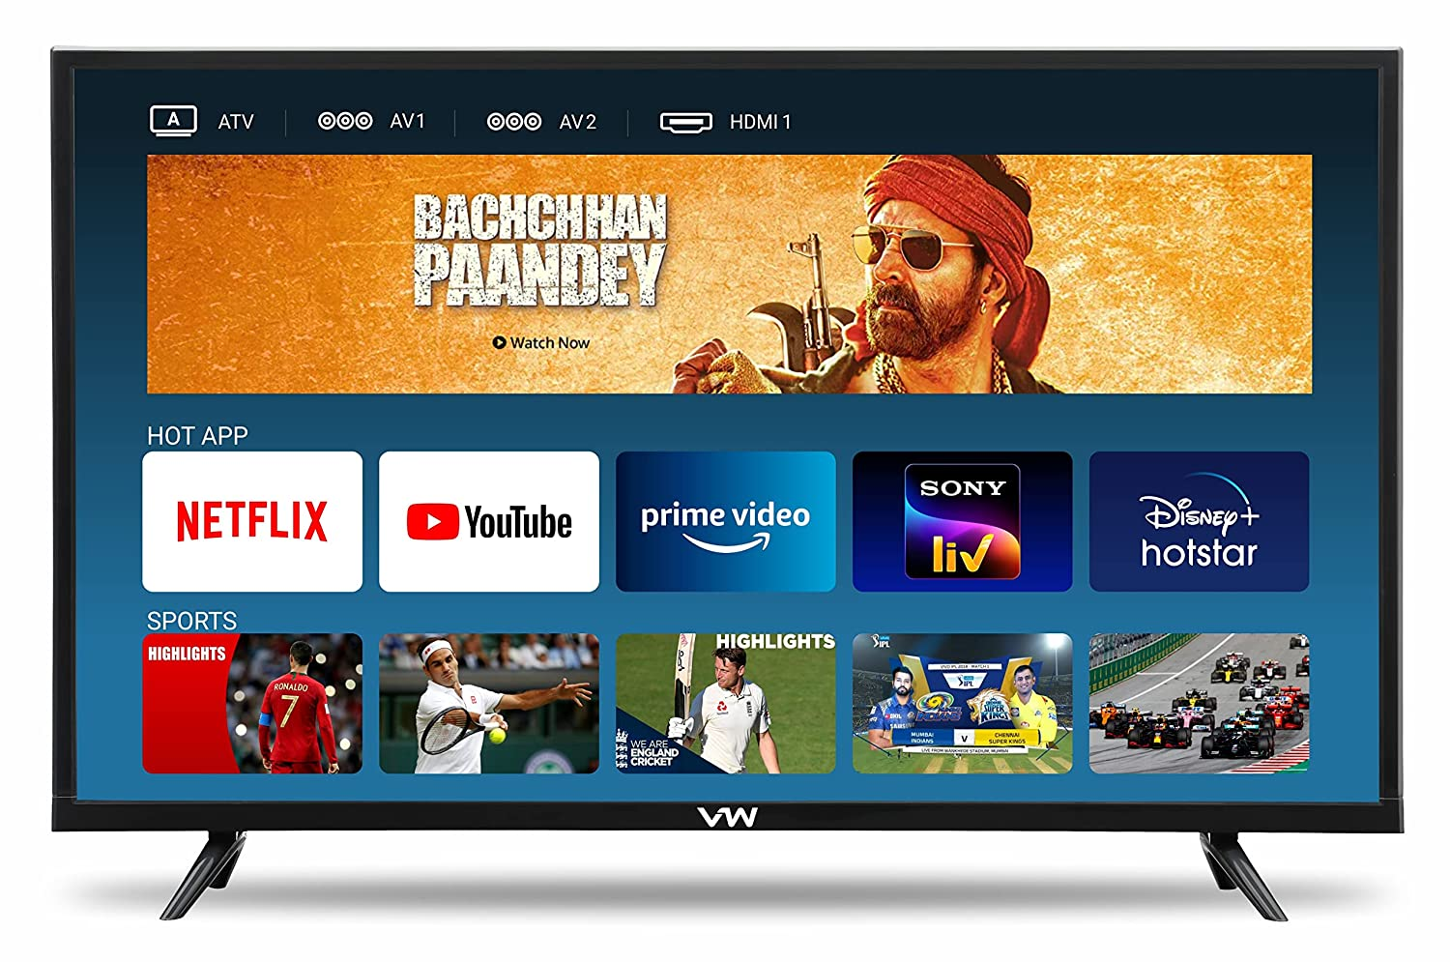
A computer may be a TV!

Slide 25
How to convert a problem to machine language?
Needs analysis
…
Well-defined problem definition
Write an algorithm in a paper or your brain!
Select a suitable programming language
Write a program
Run compiler or interpreter

Slide 26
What is hardware and software?
The hardware components of a computer system are the electronic and physical parts.
But, the software components are all things except hardware! These are data, or programs or other soft parts!

Slide 27
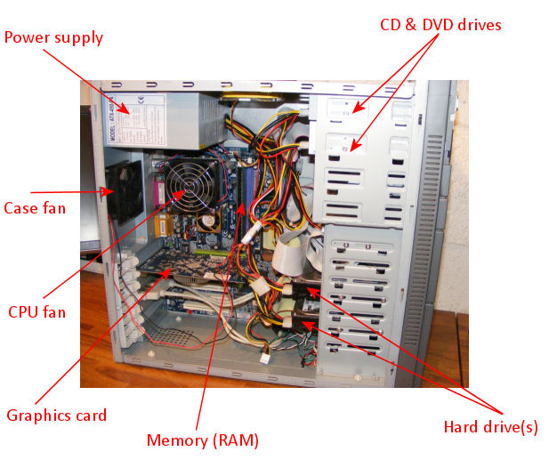
Typical hardware
Processor (cortex and neocortex)
Memory
Main
Secondary
Input device (sensor)
Output device (actuator)

Slide 28
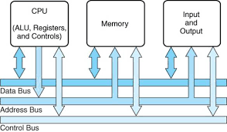
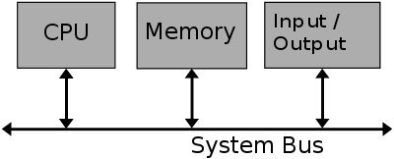
Communications!

Slide 29
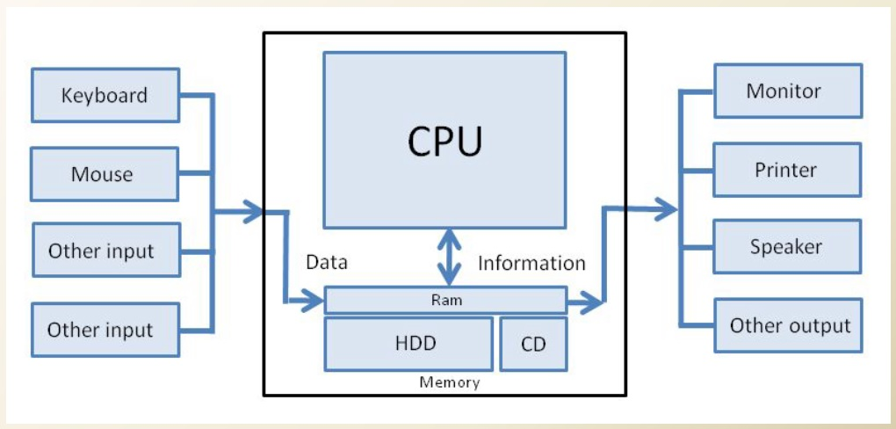
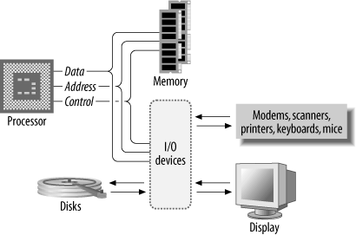
Communications!

Slide 30
How does computer start for doing tasks?
ROM (Read Only Memory)

Slide 31
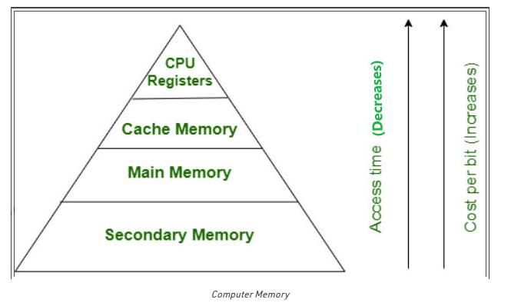
Memory hierarchy!

Slide 32
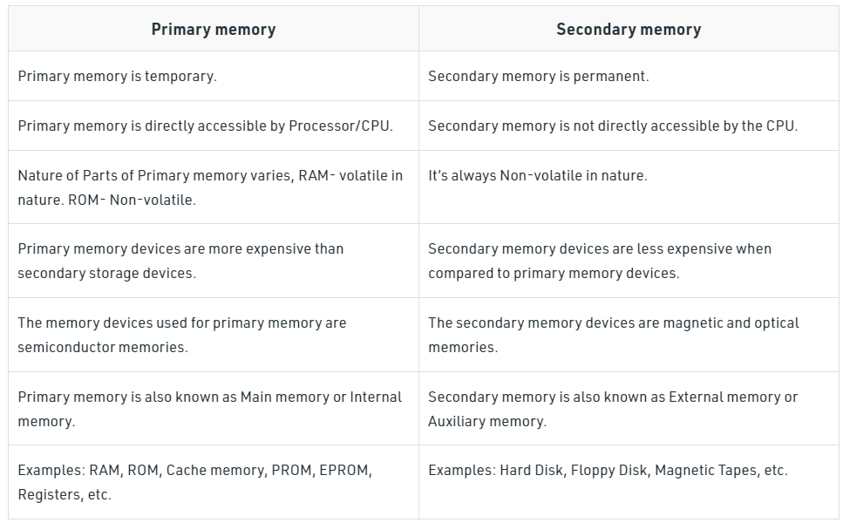
Memory features

Slide 33
Type of Programs in Computer

Slide 34
What we can run in computer?
Application programs
System programs

Slide 35
What is operating system?
An operating system (OS) is the program that, after being initially loaded into the computer by a boot program, manages all of the other application programs in a computer. The application programs make use of the operating system by making requests for services through a defined application program interface (API). In addition, users can interact directly with the operating system through a user interface, such as a command-line interface (CLI) or a graphical UI (GUI).

Slide 36
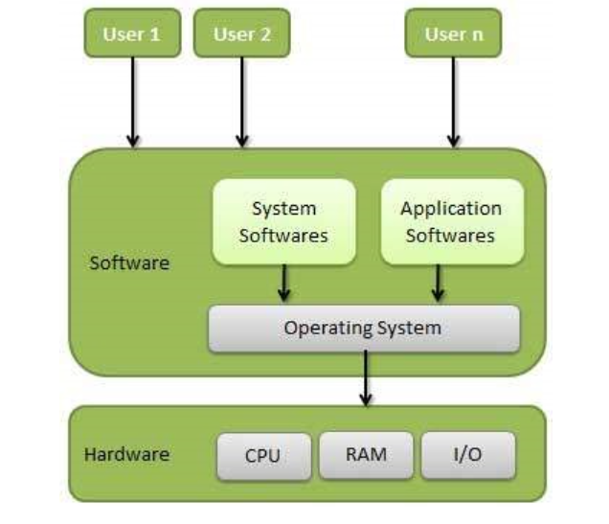
What is operating system?

Slide 37
How we can use OS?
Single OS
Dual boot
Virtual machine
Docker machine
WSL (Windows Subsystem for Linux)
…

Slide 38
Starting a program is OS
The user click or select an application program
The OS detect its name of the program
The OS get file of program from HDD or others
And send it to main memory
The OS configure the resources for the program
At last, OS is running the programming

Slide 39
How computers can connect to each other from a wide range or through the internet?
Who is volunteer for the short presentation?

Slide 40
Algorithm: Programs Brain!

Slide 41
From problems…
The problem must be translated to understandable structure (programs) for computers.
Algorithm is a step-by-step procedure for computation.

Slide 42
What is Algorithm?
A set of finite rules or instructions to be followed in calculations or other problem-solving operations.
A procedure for solving a mathematical problem in a finite number of steps that frequently involves recursive operations.
A list of finite well-defined (unambiguous) instructions for solving a problem like a cooking book.

Slide 43
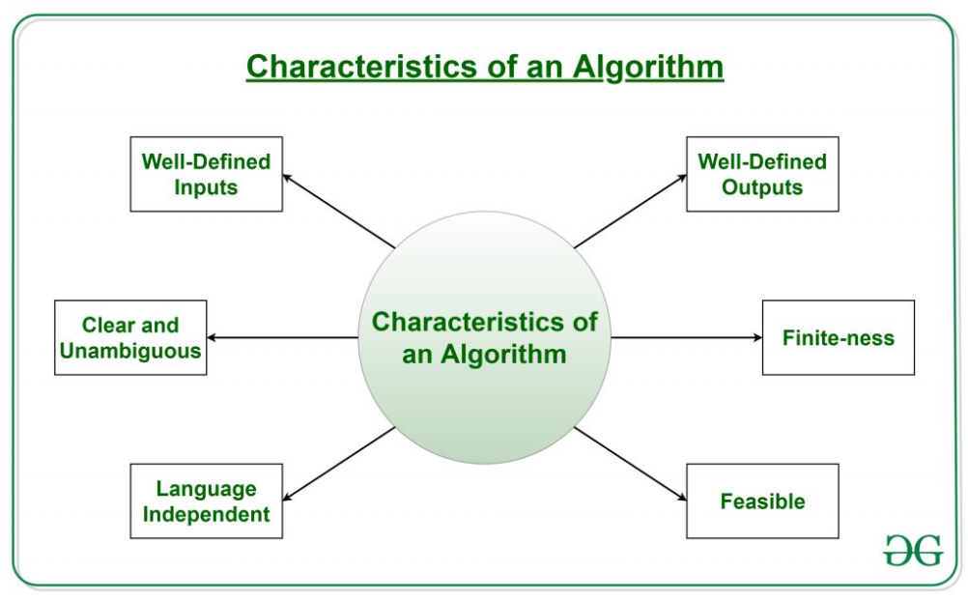
The characteristics of Algorithm!

Slide 44
What is flowchart? What is better than a flowchart?
Who is volunteer for the short presentation?

Slide 45
Application of Programming in the Digital Age!

Slide 46
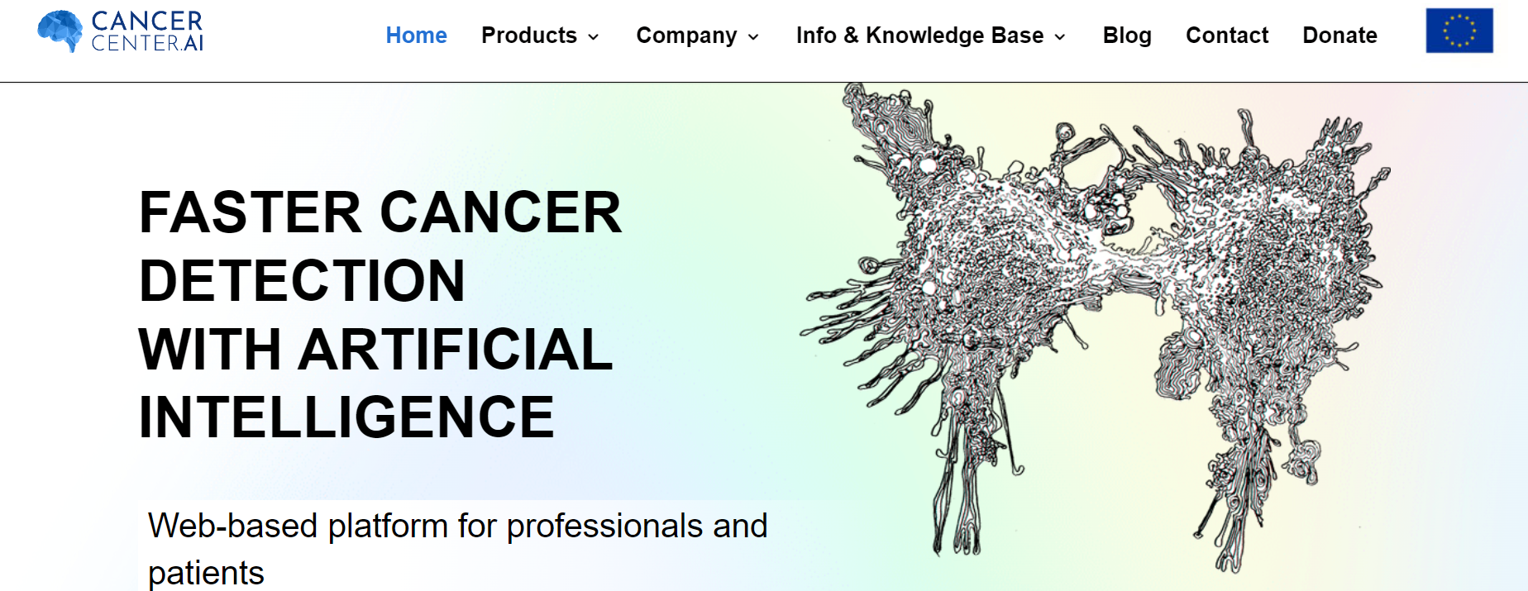
Cancer detection!

Slide 47
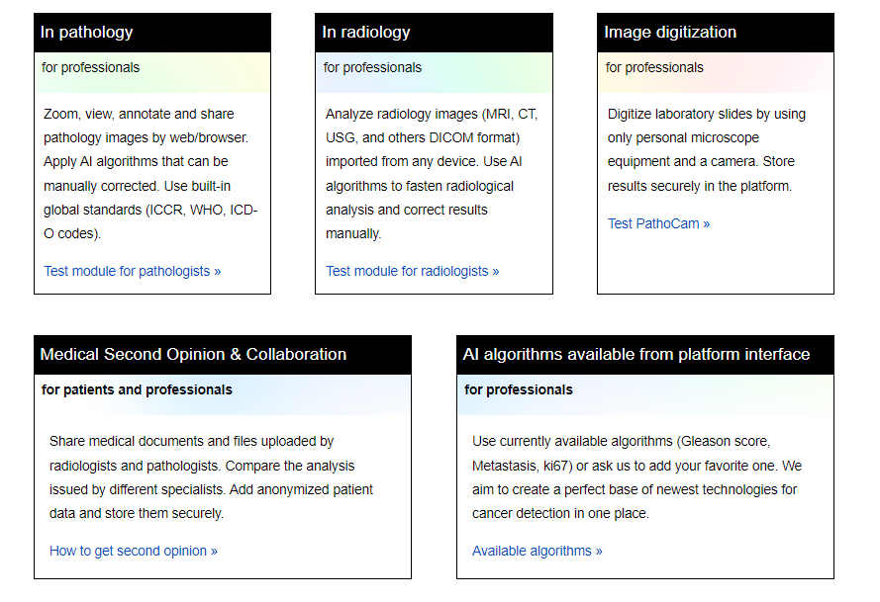
How to speed-up the cancer diagnosis process with AI?

Slide 48
Lecture Resources
P. Wentworth, J. Elkner, A. B. Downey, C. Meyers. How to Think Like a Computer Scientist: Learning with Python. 3rd Edition, Open Book Project, 2011.
https://en.wikipedia.org/wiki/History_of_computing
https://en.wikipedia.org/wiki/History_of_computing_hardware
https://www.geeksforgeeks.org/difference-between-primary-and-secondary-memory/
https://www.tutorialspoint.com/operating_system/os_overview.htm
https://www.geeksforgeeks.org/introduction-to-algorithms/
https://cancercenter.ai/

